Slide 1
Securing the Cloud
ENPM665
Kevin Shivers

Slide 2

"I don't like the looks of him. I mean, who wears socks with no shoes?"
- Branch

Slide 3
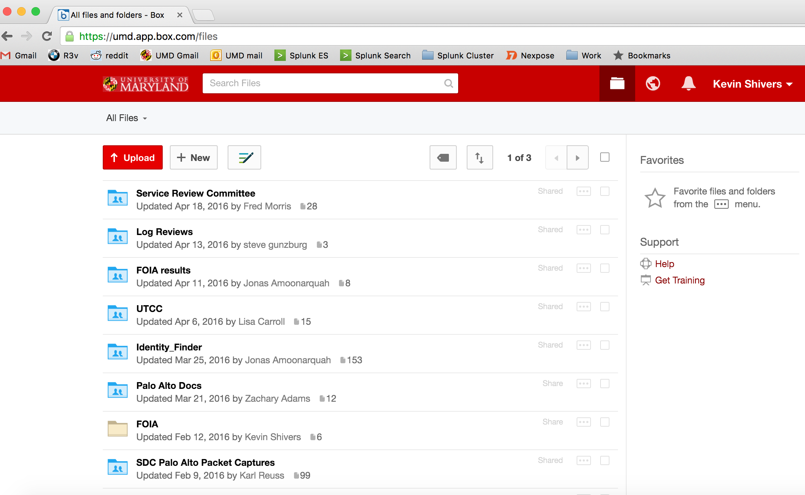
How do you secure this?

Slide 4
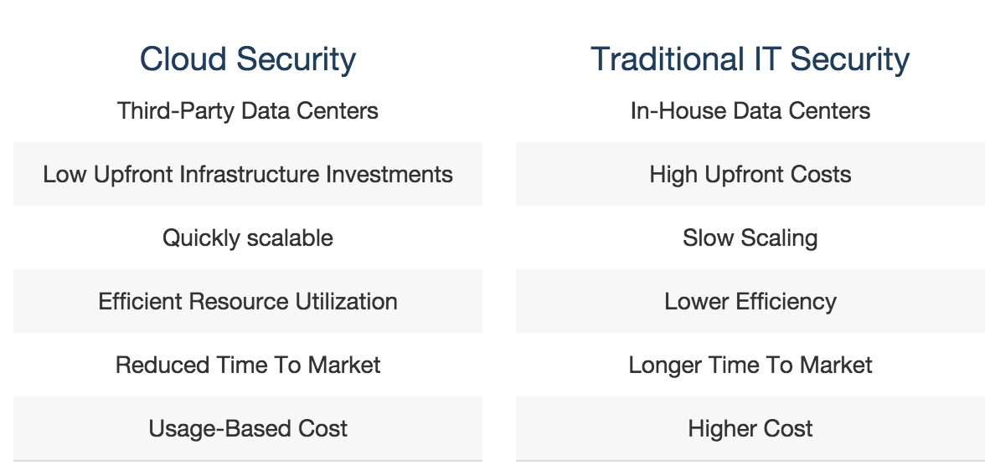
Umm…
https://aws.amazon.com/security/introduction-to-cloud-security/ (circa 2017)

Slide 5
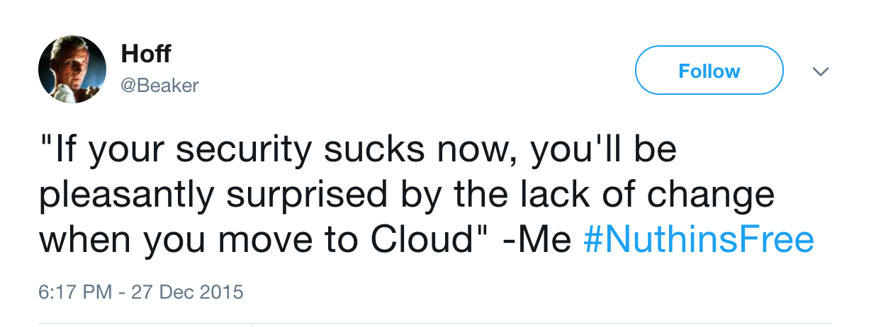
https://twitter.com/beaker/status/681252570707394561

Slide 6
Always Remember
The cloud can be as secure or insecure as you make it.

Slide 7
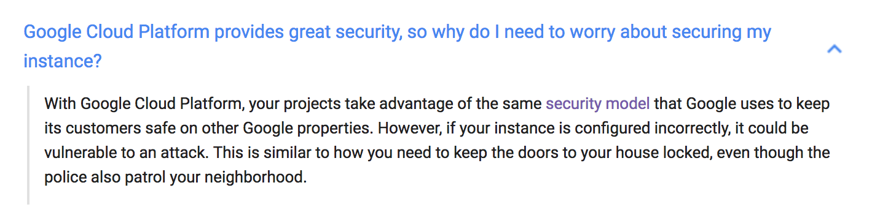
Google Says it Best
https://support.google.com/cloud/answer/6262505?hl=en

Slide 8
But the CIA uses the cloud!
Correct but the AWS setup that the CIA and other intel agencies use is physically and logically separate from the AWS that the rest of us can have
CIA’s cloud is not connected to the internet, only to the Joint Worldwide Intel Communication System
CIA/AWS have not approved all AWS services for use in the CIA cloud

Slide 9
Securing the Cloud
A lot of process and policy
Some tools where appropriate
We’ll focus primarily on IaaS in this class

Slide 10
Cloud Security is Easy!
Patching can be easier
Firewalls are built in (often with default deny!)
Asset inventory is built-in
Auditing tools are built-in

Slide 11
Cloud Security is Hard!
Who uses just one cloud?
Tools and strategies that worked on-prem don’t work in the cloud
Security staff still learning/afraid of the cloud
Sane application logic is the new network
Detection methods for advanced attacks require intel, rules, and real time analytics against your cloud event data.

Slide 12
Shared Responsibility Model
In a cloud environment the responsibility for securing that environment is shared between the customer (you) and the cloud vendor.
The level of who is responsible for what depends on the type of service.

Slide 13
On Premise
Data Classification and Access
Application
Middleware
Operating System
Virtualization
Servers
Storage
Networking
You

Slide 14
IaaS
Data Classification and Access
Application
Middleware
Operating System
Virtualization
Servers
Storage
Networking
You
Cloud
Provider

Slide 15
PaaS
Data Classification and Access
Application
Middleware
Operating System
Virtualization
Servers
Storage
Networking
You
Cloud
Provider

Slide 16
SaaS
Data Classification and Access
Application
Middleware
Operating System
Virtualization
Servers
Storage
Networking
You
Cloud
Provider

Slide 17
* Networking
This does not mean the cloud vendor will protect your data from network-based attacks.
It means other customers won’t be able to sniff your data as it goes across the wire.
You still need to encrypt, patch, reduce attack surface, firewall, IPS, etc.

Slide 18
Who’s Responsible For Securing What?
Cloud Vendor: Security OF the Cloud
You: Security IN the Cloud

Slide 19
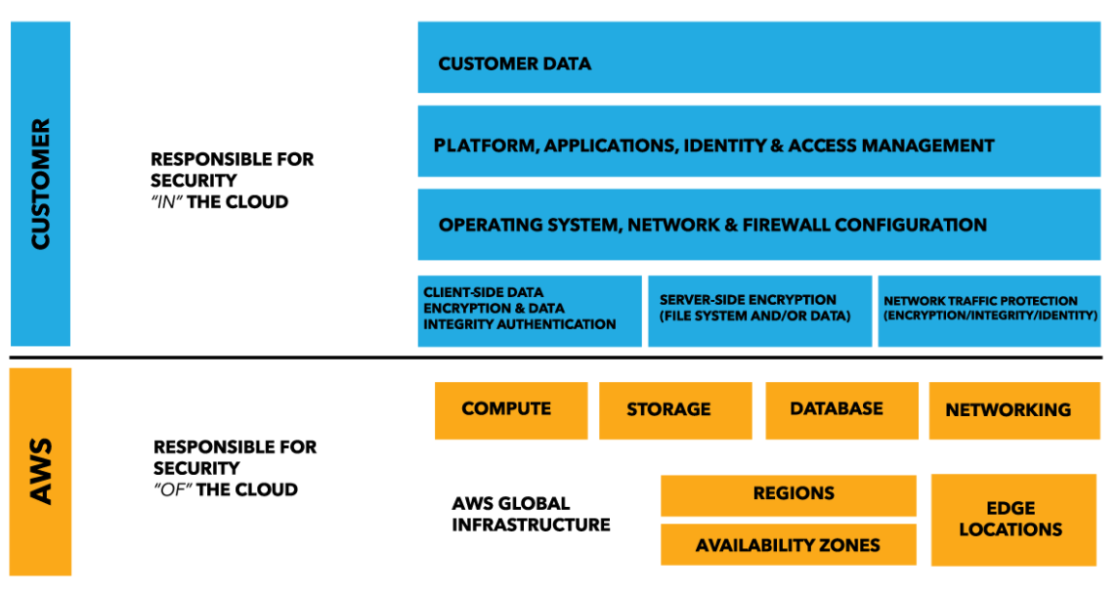
AWS Shared Responsibility Model
https://aws.amazon.com/compliance/shared-responsibility-model/

Slide 20
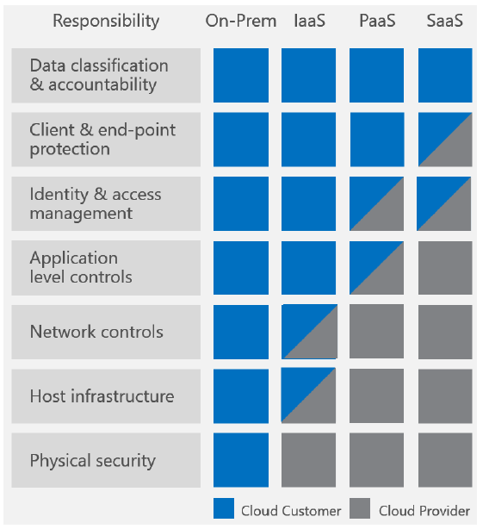
Azure Shared Responsibility Model
https://blogs.msdn.microsoft.com/azuresecurity/2016/04/18/what-does-shared-responsibility-in-the-cloud-mean/

Slide 21
In the cloud API access is the same thing as physical access in the real world.

Slide 22
If someone can access a cloud vendor’s API with powerful enough credentials they can access all your data.

Slide 23
Vendor Lock-In
By using a cloud provider you are giving up some control of your systems and data and “locking in” with that provider.
Providers want you to ”buy in” and use their APIs, technology, etc. Traditionally they have lowered prices vs raise them but what if tomorrow they announce rates go up 10X? Now what?

Slide 24
Vendor Lock-In
Think about how portable your data and systems are should you need to move.
Avoid proprietary formats where possible
Have a backup that you can access/recover

Slide 25
Vendor Lock-Out
Provider ceases operations or has a major event that requires you to stop using them.

Slide 26
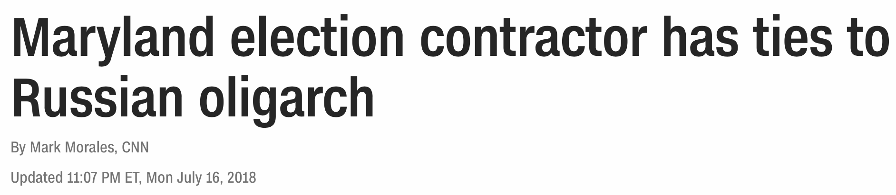
https://www.cnn.com/2018/07/16/politics/maryland-elections-russia/index.html
“Maryland elected officials are sounding off about an FBI tip that a third-party company contracted for elections has ties to a Russian oligarch, officials said on Monday.
[…]
ByteGrid LLC hosts the statewide voter registration, candidacy and election management system, the online voter registration system, online ballot delivery system and unofficial election night results website, according to the Maryland State Board of Elections.
ByteGrid is majority owned by AltPoint Capital Partners. They have general and limited partners, one of whom is Russian oligarch Vladimir Potanin, company officials confirmed.”

Slide 27
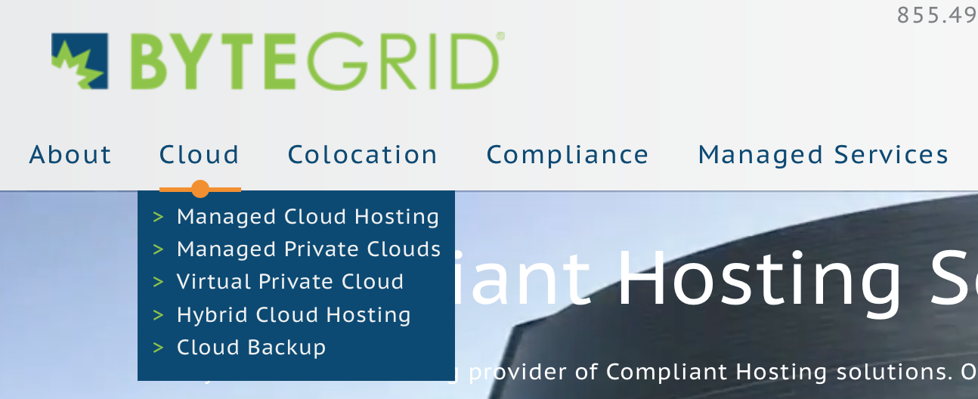

Slide 28
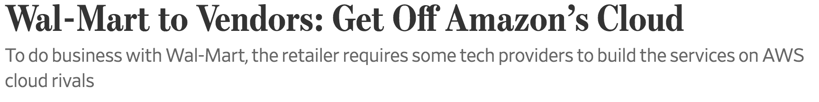
https://www.wsj.com/articles/wal-mart-to-vendors-get-off-amazons-cloud-1498037402
“Wal-Mart Stores Inc. is telling some technology companies that if they want its business, they can’t run applications for the retailer on Amazon.com Inc.’s leading cloud-computing service, Amazon Web Services, several tech companies say.
[…]
Snowflake Computing Inc., a data-warehousing service, was approached by a Wal-Mart client about handling its business from the retailer, Chief Executive Bob Muglia said. The catch: Snowflake had to run those services on Azure.

Slide 29
“People jump through hoops to do business with Wal-Mart all the time,” said Robert Hetu, an analyst with the research firm Gartner Inc. “That should absolutely accelerate the competition from Azure.”
[…]
“Everybody knows that Wal-Mart will not play ball with you if you use AWS.”

Slide 30
“Amazon’s rise as the dominant player in renting on-demand, web-based computing power and storage has put some competitors, such as Netflix Inc., in the unlikely position of relying on a corporate rival as they move to the cloud.”

Slide 31
Multitenant Environments
Conflict of interest – Provider personnel who administer your systems should not also be involved with any of your competitors. (They also should probably not also be in direct competition with you.)
Reality (for now) – personnel don’t really know or care who is using the system they are working on, they just want it to be up. But it is a risk.

Slide 32
Multitenant Environments
Information Bleed – with multiple customers using the same infrastructure it is possible that data from Customer A could be accessed by Customer B.
Data Seizure/Legal Activity – If Customer A’s data/devices are seized as part of a lawful order (evidence, subpoenaed) then Customer B could be offline

Slide 33
Virtualization Risks
Attacks on the hypervisor
Guest escape (user in a Guest OS is able to break out into other guests or the hypervisor)
Information bleed

Slide 34
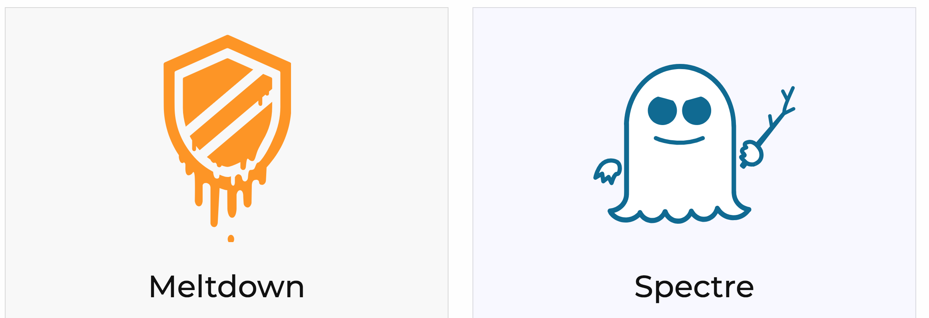
Remember Us?
https://meltdownattack.com/

Slide 35
In the Cloud your scream may be logged…
Almost everything you do in a cloud environment is an API call.
Most cloud providers will let you log all of these API calls for IaaS (often less so for PaaS and SaaS.)

Slide 36
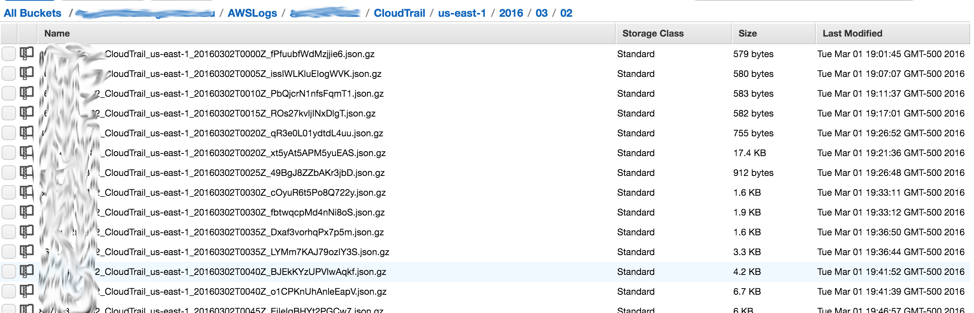
AWS API Log hunting!

Slide 37
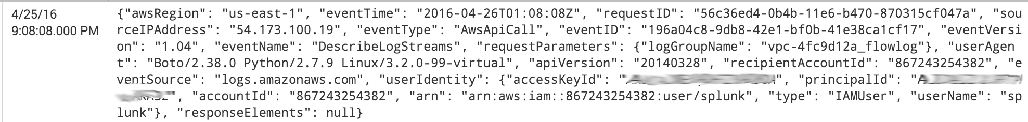
This is fun…

Slide 38
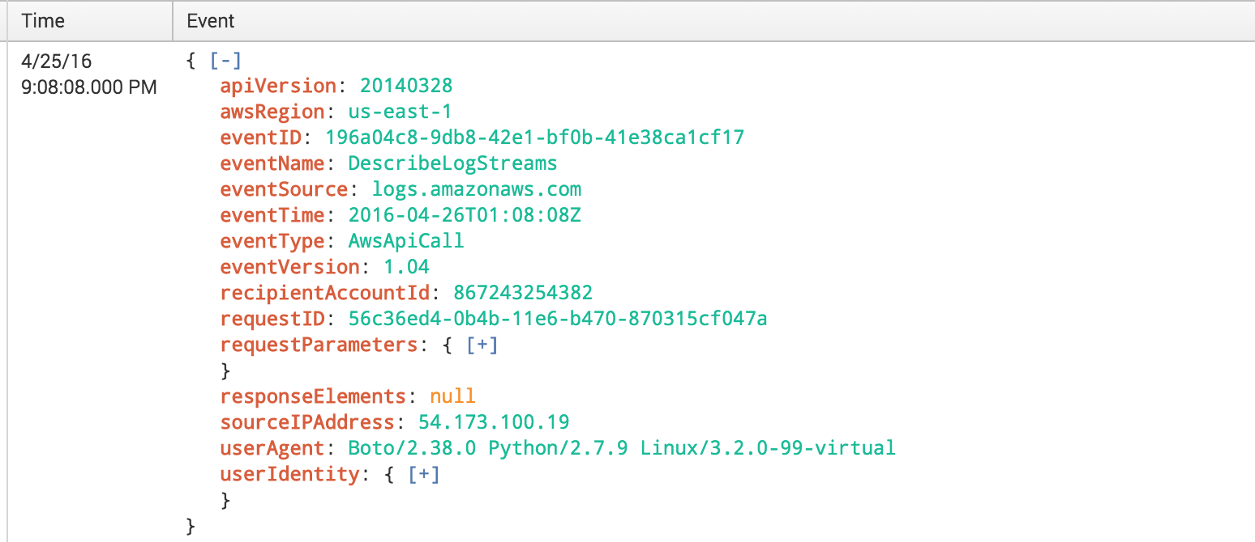
Getting better

Slide 39
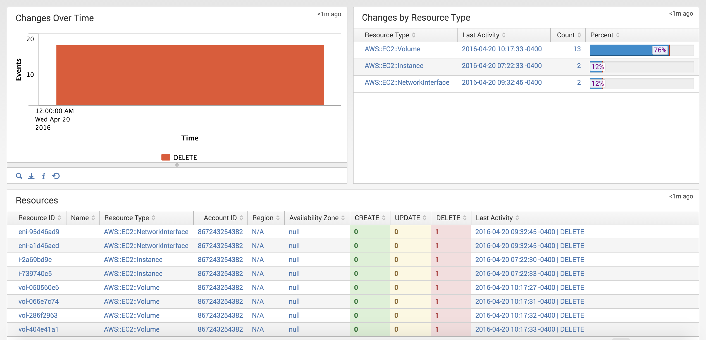
Now we’re getting somewhere

Slide 40
Finding the needles in a haystack
Console/API logins from
New IP addresses
New user agent
High rate of API activity
New kinds of API activity
Snapshots/backups outside of scheduled patterns
New IP address accessing DB

Slide 41
Traditional issues + Cloud issues
Traditional IT: secure with firewalls, IPS, AV, NGAV, MFA, etc.
In the cloud…Snapshot the disk, mount snapshot on a different system, and extract everything all without touching the system!
No indication (from the system) that data has been taken

Slide 42
Traditional issues + Cloud issues
Think about databases… I don’t need to crack DB passwords, do SQL injection, or steal your physical server.
I just need credentials and your cloud provider’s API and take a snapshot of your DB. *

Slide 43

*
Same can be said for on-prem VM systems + backups too.

Slide 44
Back to the snapshot thing
This is really common by motivated attackers. Spearphish targets to get their password/API keys and go to down.
Steal all the data in minutes/hours vs months/years!

Slide 45
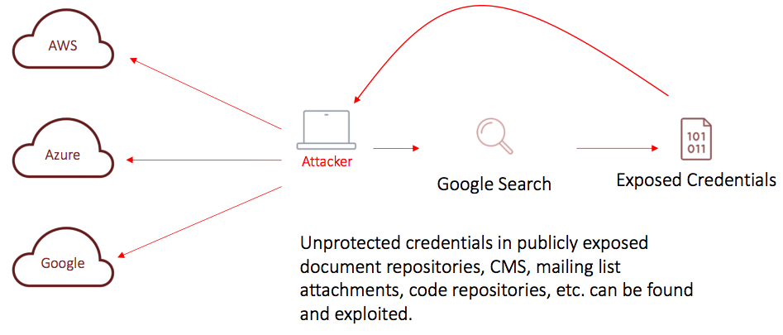
Credential Compromise via Public Exposure

Slide 46
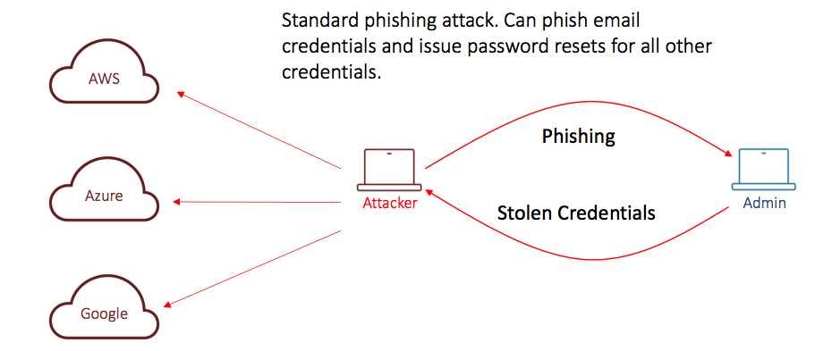
Credential Compromise via Phishing

Slide 47
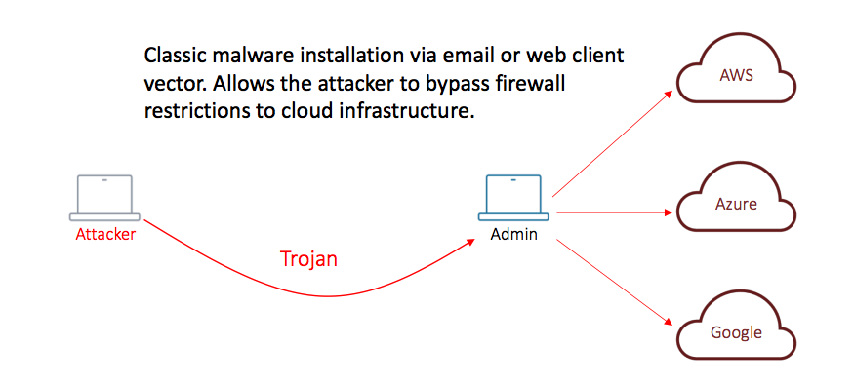
Credential Compromise via Endpoint

Slide 48
https://madison.com/ct/business/technology/cybersecurity-advisor-with-hillary-clinton-campaign-gives-insights-into-devastating/article_62b7f458-fd91-54c3-8fec-e1d2b6ccd1af.html
“Russian agents managed to access third-party servers that hosted the DNC’s website, and found a way to create “snapshots” of the website using one of the service’s backup-creation tools. While he said he remains a proponent of using cloud-based networks, he said it was a method of infiltration that was nearly undetectable.”
- Ben Hagen, Head of Corporate Security at Facebook and lead on the Obama campaign IT security in 2012, also worked with the Clinton campaign and DNC in 2016.

Slide 49
The Additional Attack Surface of the Cloud
Cloud API endpoints are open by design & trump all existing controls
Unexpected disclosures from provisioning systems and metadata
Private might be public, IP’s, data leaks through 3rd party services
Only thing standing between total compromise of your entire datacenter is the secrecy of your API keys

Slide 50
API key exposure can cause…
Cryptocurrency mining operations to be spun up in your cloud environment
Password cracking environment spun up
Applications trojaned to host malware
Exposure of all of your customer’s data
Or they just rm –fr ALL THE THINGS

Slide 51

Or they just rm –fr ALL THE THINGS

Slide 52
It’s happened before
“[Code Spaces,] A code-hosting service that boasted having a full recovery plan has abruptly closed after someone gained unauthorized access to its Amazon Web Service account and deleted most of the customer data there.”
http://arstechnica.com/security/2014/06/aws-console-breach-leads-to-demise-of-service-with-proven-backup-plan/

Slide 53
How are these API keys stolen?
API keys checked into public source control services like GitHub
The bad guys (and cloud providers) are scanning these services, you should too for your things

Slide 54
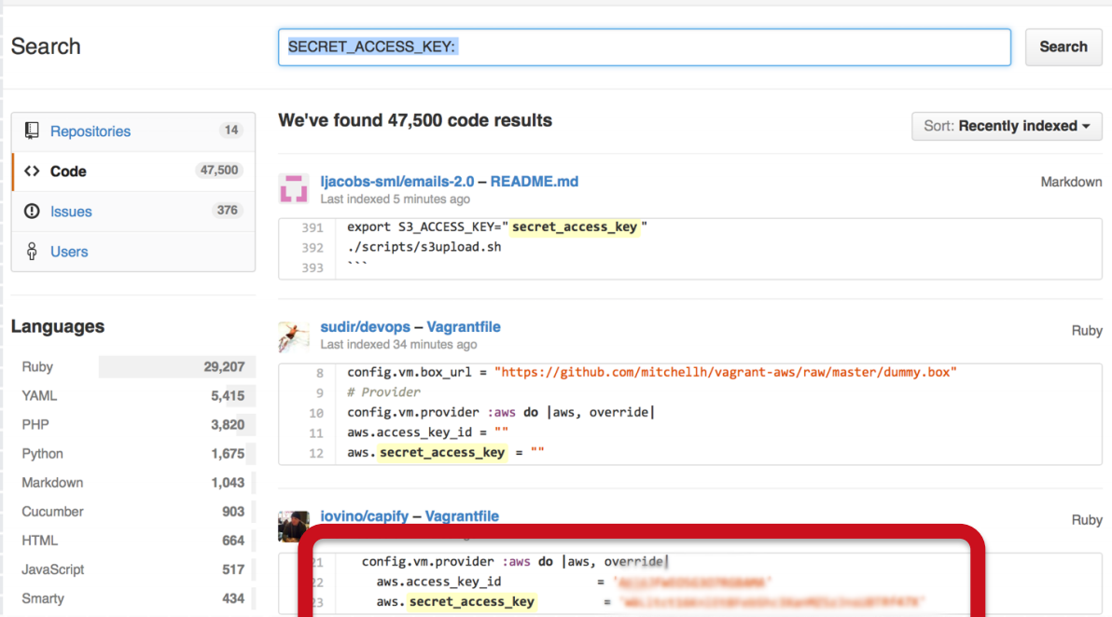
https://github.com/search?q=secret_access_key&type=Code

Slide 55
How are these API keys stolen?
Taking advantage of vulnerabilities in metadata or bootstrap systems to extract keys
Phishing/system compromise of a someone with API keys

Slide 56
Back to basics
Reduce your attack surface
Defense in depth

Slide 57
Some attack vectors don’t change
Application level (priv escalation, logic errors/bypass, XSS)
OS vulnerabilities
Server/Application vulnerabilities (Apache, OpenSSH, …)

Slide 58
Some attack vectors do change
Homogenous environment
Polymorphic targets/mapping
Reduced network sniffing

Slide 59
A shift in thinking
Less relying on traditional IT security tools and techniques
Improving processes, procedures, and some different technology

Slide 60
A shift in thinking
Host-based IPS
Continuous monitoring of logs
Host/instance logs (http, ssh, system logs, etc.)
Cloud logs (CloudTrails, Tenant Activity Logs, Flow logs, etc.)
Continuous patching (puppet, chef, etc.)
Continuous vulnerability scanning
Good user account management (instance & console)
Automate ALL THE THINGS (CloudFormation templates, Azure Resource Manager templates, puppet, chef, etc.)
Configuration management (puppet, chef, etc.)

Slide 61

A shift in thinking
svr452.enpm665.com

Slide 62

A shift in thinking
NOT
dante.enpm665.com

Slide 63
A shift in thinking
Instances are cattle not pets
Have an issue with an instance? Terminate it and start over with a fresh one *
*Unless you need to grab an image for forensics/IR

Slide 64
Optional CCSP Study Reading
Chapter 1 – Architectural Concepts
Chapter 5 – Security in the Cloud
Chapter 6 – Responsibilities in the Cloud

